Slide 1
Read .obj
Because I can’t build the meshes by PCD successfully. So, I download a .obj
Files. Why .obj extension? Because the file format is relatively easy to read.
Model.txt
Save as a txt file and read by C++ test file. It will transfer data by TCP later. This is just a simulation.
Build Tree
Read the model file and build BVH tree.
Ray Tracing
Test ray intersection
Show
Try OpenGL to show it, instead of console

Slide 2
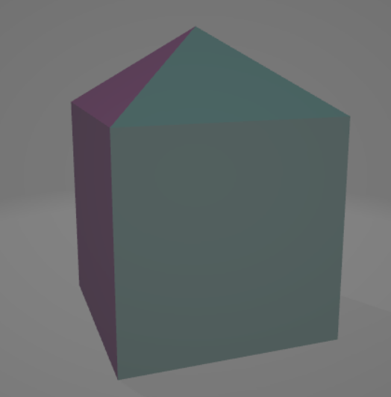
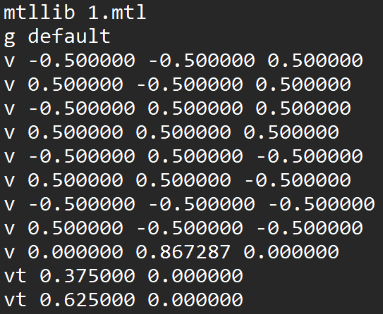
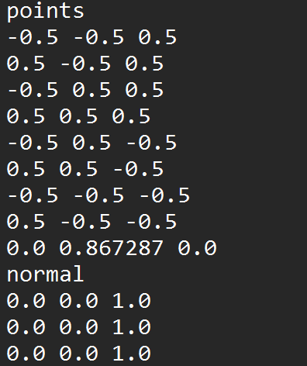
In Python
testmodel.obj
original data structure
after simplification
Notes:
CUDA Set up:
https://blog.csdn.net/qunsorber/article/details/122255530
https://www.jianshu.com/p/fa99a3e59d32

Slide 3
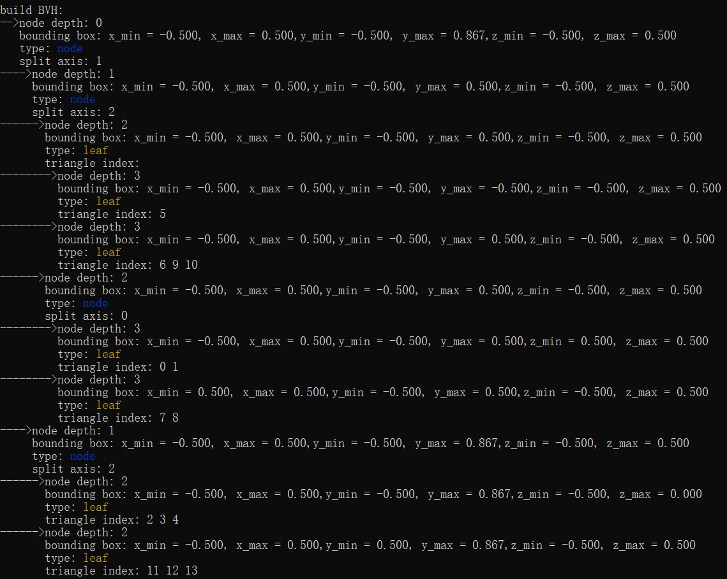
In C++

Slide 4
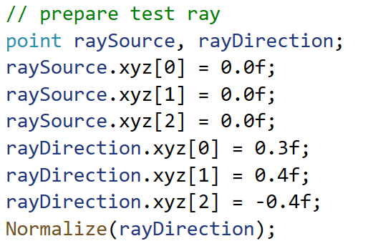
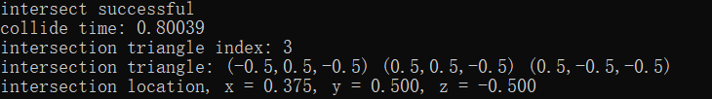
Give a ray source and a direction
show the intersection test result

Slide 5
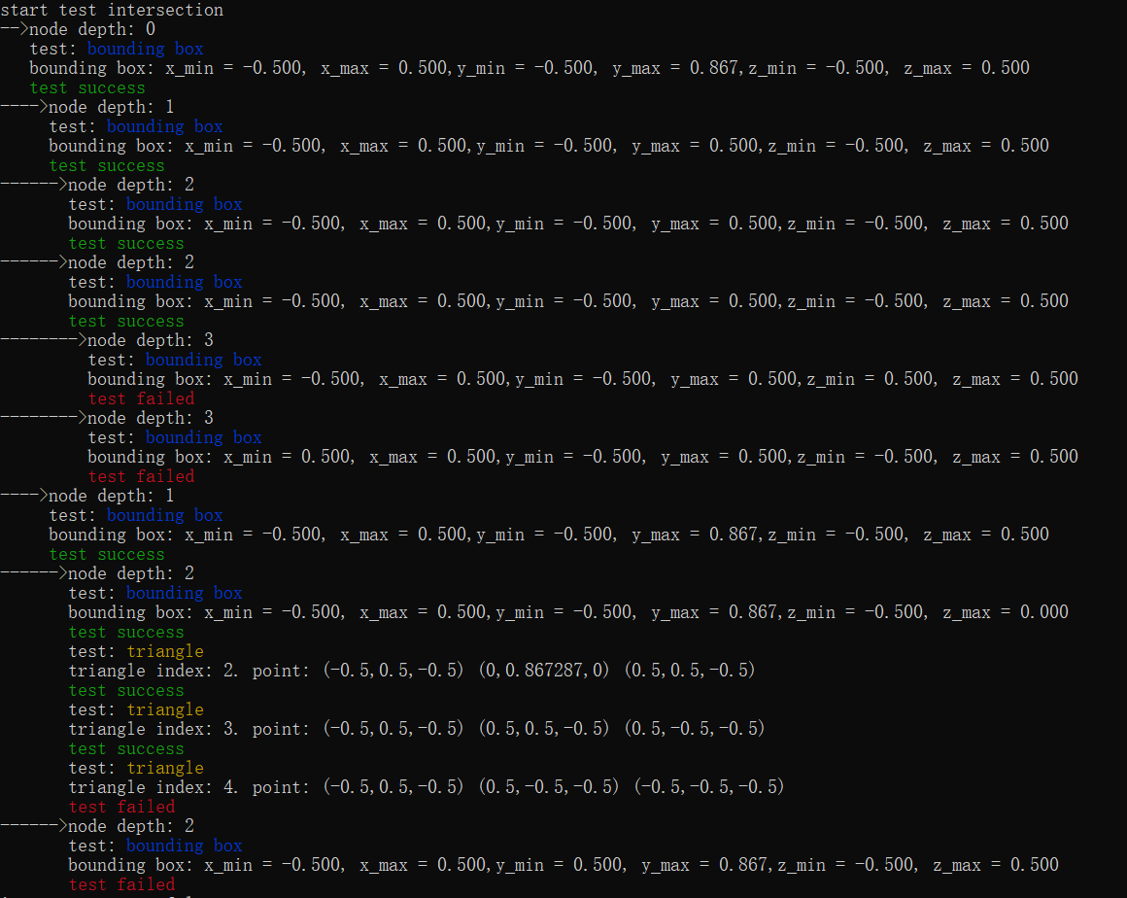
The process on ray tracing

Slide 6
What Next?
Try some other algorithm to build the triangular meshes (check Bassel’s email)
Verify BVH build program. Try to visualize the result.

Slide 7
Appendix
Notes:
CUDA Set up:
https://blog.csdn.net/qunsorber/article/details/122255530
https://www.jianshu.com/p/fa99a3e59d32

Slide 8
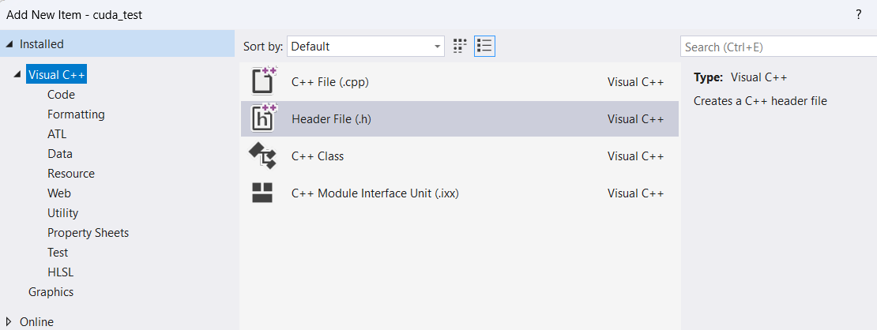
Set up CUDA environment. CUDA Manual
I can use CUDA library now, but can’t create a CUDA environment item. I will try to
reinstall CUDA
Notes:
CUDA Set up:
https://blog.csdn.net/qunsorber/article/details/122255530
https://www.jianshu.com/p/fa99a3e59d32

Slide 9
OpenGL
Only have framework (a standard), no implement. Each GPU company implement the function by themselves
gl: core library
glu: utility library
aux: auxiliary library
glut: utility tool library
glx, agl, wgl: window library
other function library
Framework API
When company implement those function, it will become part of the GPU driver. And your PC’s GPU driver must be corresponding to your GPU
Now we have GPU driver. And a unified function. But how to find those function pointer in the driver? Each company has its own pointer address, we can’t check all the company’s GPU manual. We will need a tool to manage over all the possible GPU driver, and find the function pointer automatically
Notes:
OpenGL Set up:
https://blog.csdn.net/m0_51765016/article/details/119847923
https://www.bilibili.com/read/cv8994394/
https://blog.csdn.net/weixin_45595405/article/details/122299751
GLAD and GLFW:
https://blog.csdn.net/lzz555517/article/details/123654280
https://blog.csdn.net/weixin_45595405/article/details/122299751
Glut:
It has: window operation functions, window initialization, window size, window position and other functions; callback functions: responding to refresh messages, keyboard messages, mouse messages, timer functions, etc.; creating complex three-dimensional objects; menu functions; program running functions. The open source implementation corresponding to gult is freegult.
Freeglut:
Freeglut is fully compatible with glut and is an alternative to glut. It is open source and fully functional. At present, freeglut 3.0 version is more stable than other versions, and it is recommended to use it.

Slide 10
old
GLUT
OpenGL Utility Toolkit. Stop update in 1998, we don’t use it.
FreeGLUT
Open source and new version of GLUT.
Different GPU company implement its own function. GLEW can not only find the basic function, but also the unique function of each company build. Include: gl,glu,glext,wgl,glx
GLEW
GLAD
New version of glew, and gl3w
new
It provides a simple API for creating windows, contexts and surfaces, receiving input and events. Instead of create windows handler by yourself.
GLFW
Therefore, what we need is one GLFW, plus GLAD / GLEW.

Slide 11

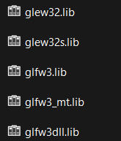



How to set up?
1. Download
glfw: https://www.glfw.org/
glew binary: http://glew.sourceforge.net/
glad: https://glad.dav1d.de/
2. Combine them by type
Put all the .h file into a include folder
Put all the .dll file into a bin folder
Put all the .lib file into a lib folder
Put all the .c file into a src folder
In bin folder:
in include folder: in lib folder:
In src folder:
Notes:
CUDA Set up:
https://blog.csdn.net/qunsorber/article/details/122255530
https://www.jianshu.com/p/fa99a3e59d32
https://blog.csdn.net/weixin_45595405/article/details/122299751

Slide 12
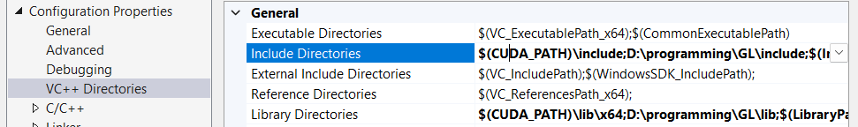


3. Set up environment in Visual Studio
3.1 Open project property:
Tell VS that you should help me include .h file in that folder. You can include such file after that. But VS will tell you “cannot find external variable”
3.2 In library directories, tell VS that you will link the file in such a folder
Notes:
CUDA Set up:
https://blog.csdn.net/qunsorber/article/details/122255530
https://www.jianshu.com/p/fa99a3e59d32

Slide 13
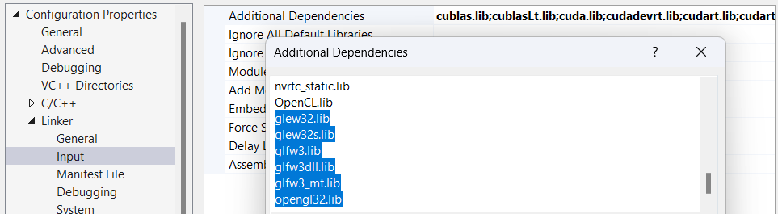
3. Set up environment in Visual Studio
In linker input option, add additional dependencies, with all the .lib file name, plus opengl32.lib (you don’t need to prepare this, it is a system lib)
Hence force, VS can link the .lib file when compiling your project.
(tips, use: “dir /b > list.txt” in CMD, can output your file name in txt file)
VS can compile it successfully, but the program will tell you no dll found
Notes:
CUDA Set up:
https://blog.csdn.net/qunsorber/article/details/122255530
https://www.jianshu.com/p/fa99a3e59d32

Slide 14
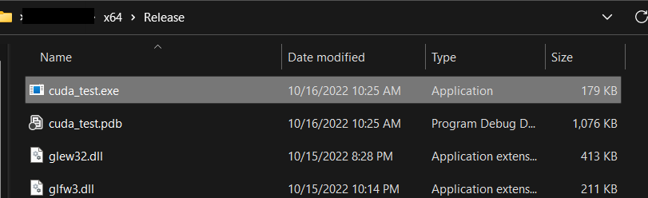

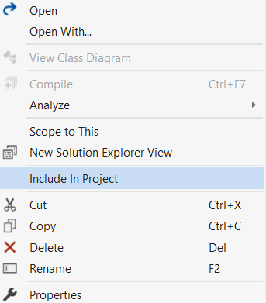

4. Copy .dll files into the output folder. .dll will be used when project run
5. Copy .c file (only one) into the source folder. glad.c will be included into your project
Include the file in VS
Notes:
CUDA Set up:
https://blog.csdn.net/qunsorber/article/details/122255530
https://www.jianshu.com/p/fa99a3e59d32

